Slide 1

What Drives Airline Passenger Satisfaction? Micro-Project #1 https://github.com/KcRyan7487/ANA500
Kasey Ryan
2025_May

Slide 2

Problem Statement
Airlines often struggle to identify the key factors that influence passenger satisfaction. Understanding these drivers can help improve customer experience and retain loyalty in a highly competitive market. We aim to answer the question: What key factors influence passenger satisfaction the most?

Slide 3
Hypothesis Formulation
Our hypothesis is that certain variables in the dataset will serve as strong and statistically significant predictors of passenger satisfaction, while others may not show a meaningful relationship. Specifically, we anticipate that the following variables will be among the strongest predictors:
Class
On-board service
Inflight service
Arrival Delay in Minutes

Slide 4
Acquire
Dataset: airline.csv
Description: The purpose of this file appears to be predicting target variable of “satisfaction” based on the other variables present in the dataset. A longer more description name might be something like “Airline Passenger Satisfaction”. A slightly flashier name might be something like “What Drives Airline Passenger Satisfaction” which we have chosen as our official name for this project/analysis/paper/presentation.
High Level Dataset metrics:
Source: Retrieved from the provided list of datasets/.csv’s to use as part of course materials for ANA-500
Raw data: 129,880 rows, 25 columns

Slide 5
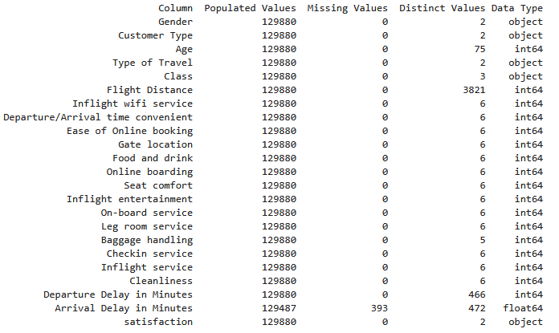
Prepare
Initial transformations: Drop the blank column at the beginning of the file (hard coded with name "Unnamed: 0“. Also drop the “id” column.
Initial data integrity checks:
0 duplicate rows
393 missing values for “Arrival Delay in Minutes”

Slide 6
Prepare (additional considerations)
Some of the variables have quite a few distinct values. It may behoove us to categorize these to a higher aggregation/granularity: Age, Flight Distance, Departure Delay in Minutes, and Arrival Delay in Minutes
We’ll have to decide what to do with the blank values for Arrival Delay in Minutes. We suspect this may be a strong predictor of satisfaction and so, if initial modeling supports that hypothesis and we suspect the variable should remain in the final model, it’ll be very important we align on the best approach. Perhaps multiple approaches could be compared such as:
Dropping missing values
Imputing them based on the global average,
Imputing them based on various nearest neighbor methods
Our target variable satisfaction only contains two possible values, a combination of neutral or dissatisfied or satisfied. Since our desired outcome is satisfied, we could recode these to satisfied as a 1 else 0 for ease of processing in future steps if/when needed.

Slide 7
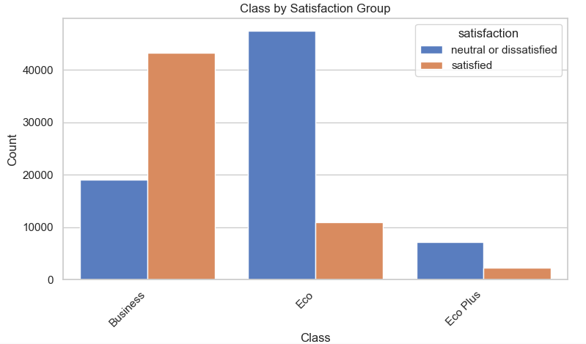
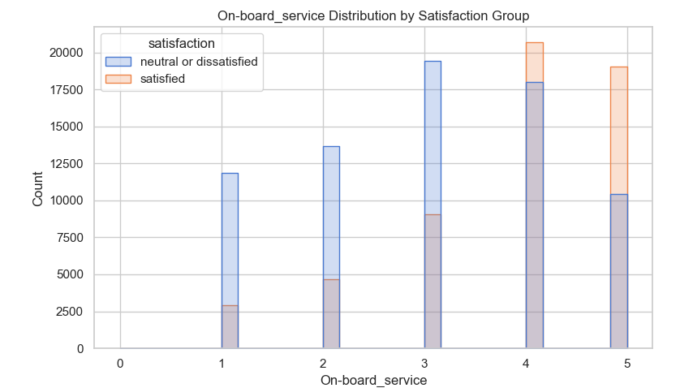
Analyze data (EDA)
Exploratory Data Analysis was performed, examining distributions/frequencies for all variables and subset comparisons by the two satisfaction groups. Some hypothesized variables’ examples are shown here; more information available in the supporting knitted pdf of the full analysis
Business class passengers are overwhelmingly more likely to report satisfaction
Economy class passengers are more likely to be dissatisfied or neutral
Eco Plus has fewer total passengers overall, but also leans more toward dissatisfaction
Suggests travel class may be strongly associated with satisfaction and is likely a key predictor
Passengers who gave low ratings (1–2) for on-board service are far less likely to report satisfaction, while ratings of 4 and 5 show a sharp increase
This visual implies a strong positive association between perceived on-board service quality and overall satisfaction.
Suggests on-board service may be strongly associated with satisfaction and is likely also a key predictor.
Further investigation needed for what specific components of the on-board service are considered in this rating to make this more actionable

Slide 8
Analyze data (Missing Values)
We opted to drop the observations with missing values for our model building for now, though will be gathering feedback from stakeholders regarding similar analyses conducted using other imputation methods
We suggest proceeding with dropping because of the low volumes involved (393 out of 129,880 i.e. approx. 0.3%) and with it the advantage of our model being based upon truly observed data
129,487 observations remain, ready for use with logistic regression model(s)
80/20 training/testing split
103,589 training / 25,898 testing

Slide 9
Analyze data (Comparing Models)
Full/complex model and other logistic regression models run to balance “goodness of fit” with simplicity and interpretability
Comparing the results using the AIC* of:
Full/Complex Model (AIC= 69425.21)
All eligible variables included
Hypothesized Model (AIC = 107019.54
Including only the 4 variables in our original hypothesis (Class, On-board service, Inflight service, Arrival Delay in Minutes)
Most Parsimonious Model using <=4 variables (AIC = 93996.83)
Included Flight Distance, Online Boarding, Inflight Entertainment, Leg-Room Service
Lowest AIC among all combinations of <=4 variables suggests this is the better “simple” model, however AIC is still not better than the full model
*Akaike Information Criterion (AIC) rewards goodness of fit while “penalizing” complexity AIC=2k−2ln(L)

Slide 10
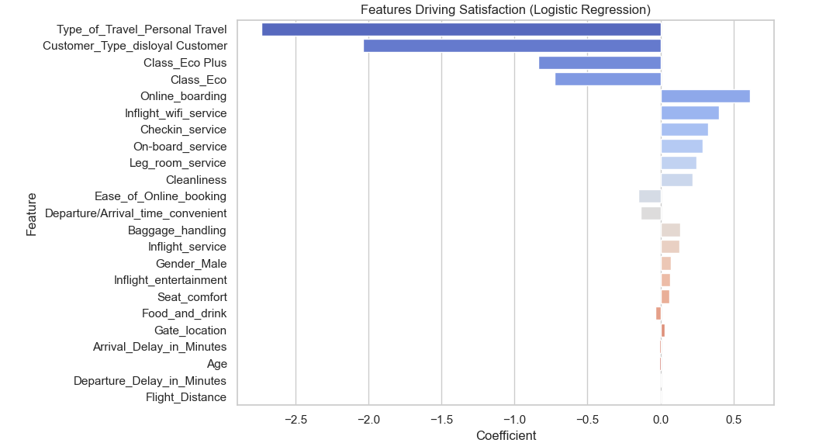
Report
Some features found to be most influential are shown here, more information available in the supporting knitted pdf of the full analysis
Some hypothesized variables do appear to have a statistically significant relationship with satisfaction
Others such as type of travel, customer type, and the “Online_boarding” variable appear to have a much stronger relationship as well
Solid performance on the testing subset of data, BUT complexity of the full/complex model may still be an issue
87% accuracy, 86% precision, 84% recall
In future iterations further refinements are planned to balance explanatory power with reduced complexity/increased interpretability

Slide 11
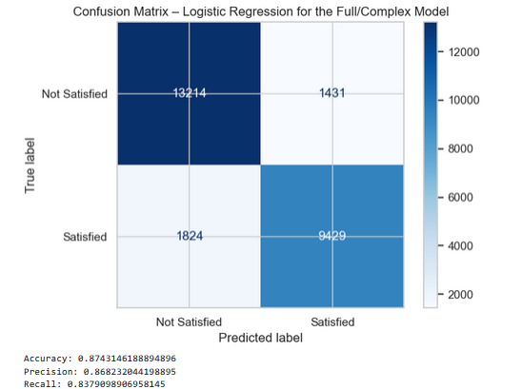
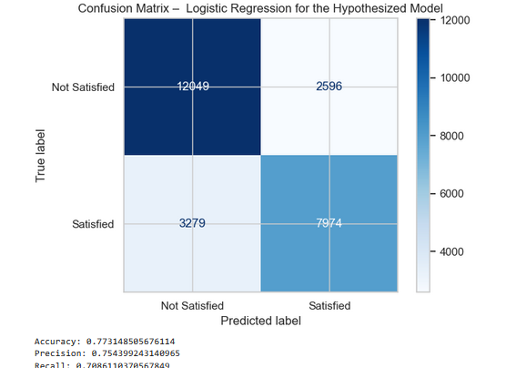
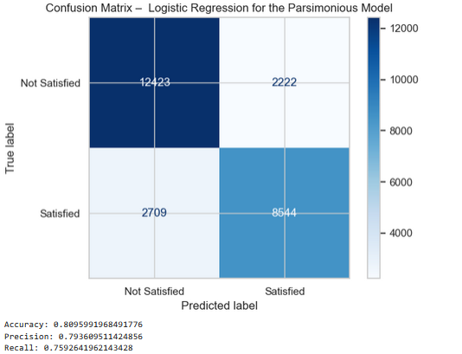
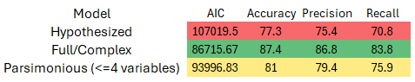
Report (Model Comparisons)
Full/Complex Model
Full/complex model has solid performance on the testing subset of data, suggesting the model may not technically be overfit. As seen in the confusion matrix visual here:
The full model correctly predicted 87% of cases overall
High precision (86%) suggests most predicted satisfactions were truly satisfied and high recall (84%) suggests the model captured most actual satisfactions
Forward stepwise selection to automatically optimize variable selection for best AIC also confirmed this model
However, practical concerns of model complexity and interpretability remain, and thus, we experimented with pairing down the model’s selected features to a smaller subset which still explains most of the variance
In further iterations we examined the AIC across 2 other models to reduce complexity and increase interpretability
Hypothesized model
Class, On-board service, Inflight service, Arrival Delay in Minutes
Worse metrics across the board, though still had adequate explanatory power
“Parsimonious Model” best AIC with <=4 variables)
“Brute forced” AIC analysis of all combinations of models with <=4 variables
Flight Distance, Online Boarding, Inflight Entertainment, Leg-Room Service
Better metrics versus the original hypothesized model but worse than full model
May be a sufficient balance for our use-case, but this decision requires more input and consideration from our stakeholders and business domain experts
Inclusion of Flight distance is particularly interesting and worthy of further investigation and consideration in future analyses. Likely this suggests flight distance may act as a proxy for several quality-related features which are known to improve on long distance (especially international) flights, such as better onboard services, legroom, etc.. The importance increases when those correlated features are excluded which highlights the impact of multicollinearity in model interpretations
i.e. flight distance is likely a proxy for better in-flight experience, not increased satisfaction from sitting longer
Hypothesized Model
Parsimonious Model

Slide 12
Act
<apply results, connect results with the chosen problem statement or business question>

